Slide 1
Designing and Developing a System Under Pressure
Or
”How to do software right even
in challenging environments...”
Advanced Software Engineering 475
Andrew McVeigh

Slide 2
Building a Commercial System
At uni we are told how to build applications
We learn about:
  Gathering requirements
  Programming, design patterns
  Architectures and different styles
  Different methodologies: agile, test-driven, iterative...
  Different modelling approaches: UML, statecharts...
And it's all very good
BUT
How do you apply these techniques under commercial pressure?

Slide 3
Under Pressure
Clients and changing requirements
  ”I've changed my mind. Here are my new ideas”
  ”Make it completely generic to cope with all future requirements”
  ”We want it cheaper, delivered faster and better”
Nasty clients who view you as inferior
  ”Deliver this or you are out of this job. It's easy, a kid could do it”
Uncaring and ignorant managers
  ”We want it now. Stop telling me about problems and just do it”
  ”I know we don't have the requirements, just finish the design”
  ”I don't know where the devices are that you need to do the work”
Managers under pressure themselves
  ”You are going to have to work all hours to make this delivery”
Cowboy coworkers
  ”I didn't understand so I hacked the fix in. I didn't make any tests”

Slide 4
So What Happens
Some projects prosper under pressure
  Systems developed under great pressure that are still around
  Architectures with strong themes that have been ”handed around” and still kept their structure
  High morale and a team culture that supports developers
  A business that ”buys into” the vision that gives wage increases
Some projects fold under pressure
  Systems delivered late or never at all: lots of money wasted
  Unmaintainable systems that are being continually rewritten
  High turnover of staff from poor morale; no ”team bonding”
  Stress causing sickness: hospital visits in extreme cases
  (Unfortunately, I'm not joking about this. It happens)

Slide 5
What Are The Differentiators?
Why do some projects do well and others badly
  What causes pressure to help some projects and harm others?
  What are some signs of project failure and ways to move it in a positive direction
It often depends on the reaction to pressure...
This is an ”attempt” at a set of guidelines for different situations
  Ways to approach different aspects of making software
  Coping strategies for pressure and badness
  How to normalise the situation and move towards goodness
  How to avoid the common pitfalls: signs to look for
  Retaining professional integrity (and character) under pressure
  Perhaps most applicable to large systems

Slide 6
Case Studies
Case D: Deathmarch
  £100m system; complete rewrite of a large business suite
  Financial applications
  Complete failure, multi-year programme delivered no value
  Outsourcing, insource, consultants, famous names
  CEO fired from prestigious role
  More common than you think
Case S: Surprisingly successful
  £30m initial system; new business system developed over 3 years
  Smartcard issuance and personalisation system
  Started badly initially; people left under little direction
  Finally: 12 week delivery period under great contract pressure
  Still being developed, maintained and sold after 10 years

Slide 7
Work To A Methodology...
(it actually helps)

Slide 8
What is a Method(ology)?
An approach to structuring, planning and controlling the development of software
http://www.cms.hhs.gov/SystemLifecycleFramework/Downloads/SelectingDevelopmentApproach.pdf
http://en.wikipedia.org/wiki/Software_development_methodology
These are the general guidelines that determine:
  How and when you gather requirements
  What documentation needs to be produced
  How you plan releases: when and how often
  How you do system and acceptance testing
Lots of variability in processes:
  Iterative and incremental versus waterfall
  Lots of ceremony (documents etc) versus little
  Prescriptive (defence + critical systems) versus descriptive

Slide 9
Modern: Iterative and Incremental
Follow a set of steps to deliver iteratively
Gather
requirements
What do
they want?
Iteration #1
Do some
design
How are we
doing to do it?
Develop
Time
Iteration #2
Gather
requirements
Let's code it
Let's code it
Integrate and
System test
Do some
design
Let's check it against
the requirements
Develop
Deliver iteration #1
etc...

Slide 10
Mistake #1: No Methodology
AKA: Throw smart people together into a room...
  ”They'll work it out together, they're smart enough”
This happend on project S
  After 6mths of little progress, no progress → disaster looming
  Lots of people left due to stress and disorganisation
Finally, roles and a light process were introduced
  People hired who knew how to organise others → managers
  People hired who knew how to structure large systems so lots of people can work on it at once
  Lucky escape?

Slide 11
Mistake #2: Too Much Ceremony
2 big issues
  Too many documents to produce, too many steps to follow
  Too ”waterfall”: no iterations
requirements
Produce 300 page document describin
everything down to screenshots of GUI
design
Produce full design of system
With lots of line and box diagrams
Code quickly because everything
is known
code
Integrate &
test
Test this and release it
What if something goes wrong?
How can you design all up front?

Slide 12
Mistake #3: The Silver Bullet
Methods can hide lack of competence
  People look like they are doing work
  But they are just following steps and shuffling paper
  The method becomes the boss...
  System D did this
  (Lots of ex-Cobol programmers trained for OO and RUP)
A method is not a silver bullet!
  It cannot kill the ”werewolf” of software
  A method does not guarantee success
  Lack of a method does not guarantee failure
  But... as a project gets bigger, processes are needed

Slide 13
My Preferred Approach
Follow a process
  Studies show that a process is usually better than none at al
  Push to move towards iterative
But...
  Keep it light and not too prescriptive
  (avoid making documents that are not required)
  (a process must help, not hinder)
  Prefer early and iterative development
  (i.e. delivery quickly and build on this in a principled way)
  Tailor the process for the environment
  Look for a standard way of documenting requirements and design

Slide 14
Some Common Sense
Requirements:
  Work out what is required for the deliverable
  Work with the clients/customers/business
  Document this: find a way to communicate this to stakeholders
  (stories, use cases)
  Expect changes, be flexible → more on this later
Design & code usually interact
  You will be sometimes asked to design/code before requrements!
  → if so, make your own requirements and document them
  Do some design, don't expect code to magically be well designed
  Design and coding often go hand in hand
Sometimes high ceremony is actually useful
  Military / space / telecomms / critical systems. CMM5 etc...

Slide 15
Interesting Waterfall Survival Technique
Sometimes people will force waterfall on you
  You can fake an iterative process within this
  This is the way the Booch process used to actually work
requirements
design
code
Integrate &
test

Slide 16
Requirements and Analysis
Understanding and agreeing
the problem to solve

Slide 17
What is Expected of the System?
Find a way to describe this in terms stakeholders understand
  Describe the operation of the system from a user's perspective
Smart card system
(1) User requests
new card
(2) system builds applications
(3) system gathers data
(4) system loads apps
onto card

Slide 18
Good Requirements Practice: Listen and Filter
Make sure you actually gather requirements!
Listen to the users
  If they are experts in the domain, listen especially carefully
  Don't try to be too clever: listen and replay back
However, don't give them everything...
  Filter out silly stuff or things that are not helpful
  Work out what is essential versus what is cosmetic
Expect requirements to change
  Look for a core that is common despite change
  Listen carefully to the language of the users, this is unlikely to change particularly if they are experts in the domain...

Slide 19
”Make me a generic system”
ie. We want this software to clear all financial products
  The problem is, unless we are experts, we don't know if it can
  The very idea, though, is often attractive to business people
Be very careful when you hear the word ”generic”
  Even seriously good domain experts cannot predict the future
  Test any requirements by making them concrete
    i.e. We will clear a swap using the generic process in the following way
    i.e. We will clear a repo using the generic process in the following way...
Too often ”generic” is a synonym for
”it can't be that hard” or
”everything is really just the same thing”
  → i.e. the wish for a silver bullet that will take away all IT problems

Slide 20
Analysis
Forming a conceptual model of the system
Find a comfortable way to express this
  For me, it is UML
  Walk through the steps of the requirements with the analysis model
Tip: If you cannot describe it, you cannot build it
(1) get cardholder details
request
cardholder
(2) build an application
using the data
(4) load it onto the card
application
smartcard
delivery
channel
(3) package it with card security data

Slide 21
Pitfalls
Trying to specify the entire system all at once
  Do it in iterations: ”here are the requirements for iteration #1”
Getting no requirements
  Can we create a system without sharing a common view on what it does?
Doing too much analysis
  ”Analysis paralysis” is suprisingly common
  Do just enough analysis and move onto designing and coding
Doing no analysis
  Analysis helps clarify the situation, may even affect requirements
Not listening to the language of the domain experts

Slide 22
Designing the System
Agreeing on common
concepts and structure

Slide 23
What is Design?
My opinionated view:
  It's an elaboration of the analysis model
  Make packages for each of the major concepts and then think about what is needed in each of the packages
  Use interfaces for major design concepts

Slide 24
Pitfalls
Doing too much up front design
  Design and coding are synergistic activities
  Too much design prevents the start of coding which might show flaws in the design
  Spend maybe a few days to a week to understand the structure
Doing no up front design
  Can we create a system without sharing a common view on how it is structured? Not if it is large...
  ”No design” approach can work if the team is small and work together very closely
  Otherwise, look to ”get onto the same page”
  Push back if management say ”just code this up”

Slide 25
Pitfalls (2)
Not approaching the design as a team
  Involve others, brainstorm, listen to comments carefully
  Try to agree as a team
  Involve senior and junior developers
  Develop a common language for the domain and design approaches
Doing the design as a paperwork exercise
  i.e. we are doing this to tick the box that says ”design”
  Push back on this, unless on a critical system
  Make design appropriate for the task at hand
Too much design by pattern
  Quite common at one point: ”we have a composite here and a singleton here...”. Patterns aren't meant to be used like this!

Slide 26
Coding the System
The fun bit...
but you must do
automated unit testing

Slide 27
And then onto coding...
This is the fun bit generally: a teambuilding exercise
But, ensure that you write automated unit tests
  ”Programmers who don't write unit tests are not professional”
  Adopt a test-driven approach if possible
  Treat the tests as part of the codebase
  Learn techniques for unit testing in complex situations
  (e.g. with databases, http etc)
  Measure your coverage
  Think about what and why you are unit testing
  ”Unit testing is your friend. They let you refactor and fix breakages. Static typing is not enough”

Slide 28
Unit Testing: A Personal Account
It's easy even for old programmers like me:
  Several years ago
    No real unit testing, I knew I needed it but...
    Too much work to make and maintain tests?
    It seems to take much of the fun out of coding...
I've managed to incorporate unit tests into my programming ”rhythm”
My old way
My new way
Write some code
Same effort
Write some code
Write tests
and verify
Manually test and verify
Change some existing code
Change some existing code
Less effort!
Manually test a bit
and hope for the best...
Rerun tests and maybe
write a few more...

Slide 29
Unit Testing (2)
What if you work on a legacy system without unit tests
  Start making them now!
  Integrate the creation of these into programming practice
  Start measuring coverage and working out how to improve it
  Work at testability... interfaces really help here
  Treat it as a learning exercise:
  introducing modern practices into old software
What if a co-worker won't unit test??
  Write some tests and educate them (or shame them ;-)
  Ask for it to be included as a daily build report
  Mention it to management if they don't listen...
As for me:
  I will not employ someone who doesn't unit test
  I always ask questions in the interviews about unit testing and testability techniques: i.e. Avoidance of singletons etc.

Slide 30
Delivering Quickly Without Compromise
Horizontal and Vertical Slices

Slide 31
Getting Results Quickly
The challenge: getting tangible results quickly
  Establishes a baseline system, rather than just bits
  Gives confidence in the system to management
  Builds up momentum for the next iterations
  Prevents the project from being cancelled!
So, how do we get results without compromising on:
  The structure and design of the system?
  Testing of the system?
  The hours we work? (i.e. Let's not kill ourselves and have no life)
  The long-term quality of the code?
  ANSWER: a vertical slice!

Slide 32
A Vertical Slice is an End-to-End Story
E.g. The delivery of a single application onto 1 card
  Might be very ”thin” functionality but it is end-to-end
  Demonstrates a complete story
  We can build out the functionality later (horizontal slices)
(1) request via
web interface
(2) build small app
(3) load it onto a card
via the web

Slide 33
Vertical versus Horizontal
System
request
Iteration #1
End-to-end
delivery
cardholder
Vertical →
Features needed
for a story or
use case
application
smartcard
delivery
Horizontal →
Richness of function and options

Slide 34
What About Cutting Corners?
request
An expedient
Implementation?
i.e. No real security?
Use interfaces!
cardholder
application
smartcard
delivery

Slide 35
Keeping Expediency Segregated...
Use interfaces to separate components
  Expedient code should not mingle with real code...
  Use horizontal slice in an iteration to fill out over time
request
cardholder
application
smartcard
delivery
channel

Slide 36
Iteration #2: Real Application Security
request
Security subsystem
added to application
layer
cardholder
application
smartcard
delivery

Slide 37
Slices
Use vertical and horizontal slices to plan iterations
  Vertical to get results, built momentum
  Vertical to test architecture, verify design
  Horizontal to bulk out functionality
  Horizontal gets filled out as we do more vertical cases
Use interfaces between components
  Allows us to segregate expedient and production-ready code
  Builds up a design and an architecture for us
  Interfaces should correspond back to analysis model in some way

Slide 38
Iterating Forwards
Keeping up momentum

Slide 39
We Have Momentum...
We've delivered a vertical slice
We've worked hard and have delivered
  Management are happy, people are smiling again...
  But we can't keep going at this pace forever
How do we sustain and ”nurture” our momentum?
Tips:
  Have some level of organisation: Timeboxing and DSDM
  Manage expectations to avoid overwork and burnout

Slide 40
Timeboxes: Gently Pressuring
Strange observation:
  ”A programmer will often take twice as long to do a task as they estimate”
  So, we take the programmer's estimate, double it and put it on a plan
  … but then they take double that!
This is a bit harsh
  But, I've noticed it in myself
  As timescales get longer, I relax and avoid too much hard work
Timeboxing lets us avoid this odd dilemma
  Keeps gentle pressure on people
  Lets them work to their own estimates

Slide 41
Timeboxes: Spring Loaded
Bob estimates that:
  Task A, B, C, D will each take 1 week
Our iteration is 4 weeks
  MoSCoW classification
  Task A is a ”must”, B is a ”must”, C is a ”should” and D is a ”could”
The team timebox..
Bob's work:
Task A
Task B
Task C
Task D
...
Jill's work:
Task Q
Musts can only take 50% of the timebox time → These definitely must be done
Bob ”should” also do the shoulds... We shouldn't really take 2x as long as estimated
If he has time and is super-productive, Bob might also finish the ”coulds” and ”woulds”

Slide 42
Timeboxes: Why They Work...
Musts are never more than 40-50%
  These must get finished or the timebox is deemed to have failed
  The team doesn't want this generally...
  But, based on the estimates, the 2x effect is ok as long as the musts get done
But, seeing the other tasks makes us go faster
  We ”should” really get the musts finished and move to the shoulds
  Gives people a chance to show how productive they are
General rule:
  People will try really, really hard to make an achievable deadline
  They will give up for something unachievable...

Slide 43
Some Tips
Must 50%, Should 25%, Could 15%, Would 10%
If you are the team lead
  Have a private word with non-performers
  Avoid embarrassing people in front of the team
  They may have reasons for not getting the work done
  But...
  be fair and firm → pressure those not delivering
  Use historical data to get more accurate estimates
  Some people underestimate constantly
  Some people give silly estimates to make their lives easy

Slide 44
Some Tips (2)
Manage the client's expectations
  Don't ”promise the earth”
  Don't underestimate or cut estimates just because...
  Clearly articulate what each iteration will deliver
  But have an end-state vision of the system to work towards
My own personal bug-bear
  Never show a finished or polished interface for an early iteration
  It gives the appearance that the project is nearing completion
  Don't make it look amateurish, but put in obviously unfinished bits
    i.e. Stock images, incomplete graphics etc.

Slide 45
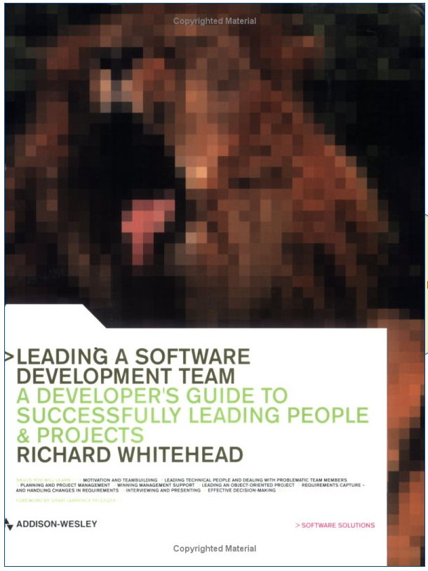
If You Get To Be A Team Lead...
Read this book. It shows how to:
  Take on an existing project
  Handle non-performers
  How to manage expectations and motivate the team
Leading a Software Development Team:
A Developer's Guide to Successfully
Leading People and Projects
Richard Whitehead
(I really wish I'd had a book like this in the
early part of my career...
I learnt a lot the hard way)
Disclaimer: I just like the book, I don't know
the author...

Slide 46
Developing an Architecture
Structure and themes that
everyone understands

Slide 47
The Full Vision and System Structure
Ensure that people know what the entire system looks like
  So they will know how their bit fits into the system
  Should be simple enough to show the business / client
  Everyone should buy into this
  Establishes a common vocabulary and terminology

Slide 48
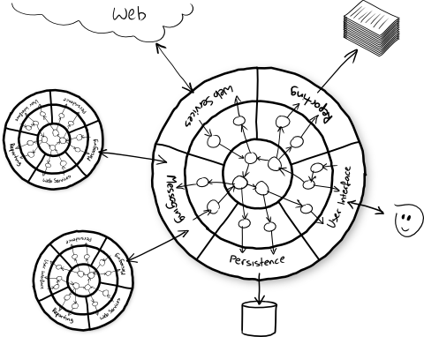
An Example from Nat...

Slide 49
Architectural Pitfalls
Making the system too complex
  Why does it have to be difficult? To justify the architect's job?
Reliance on complex technologies
  At the core, it should just be objects without coupling to EJBs or complex middleware or databases
  Use Nat's ports and adapters pattern to do this well:
  http://www.mockobjects.com/book/object-oriented-style.html
  http://natpryce.com/articles/000772.html
  Or buy (or download ;-) his excellent book:
    ”Growing Object-Oriented Software Guided By Tests”
    Freeman and Pryce...
    Lots of good advice in there...

Slide 50
Project D Case Study:
A ”Generic” Financial System
Flawed in principle...

Slide 51
A Completely Generic System
The goal was to create a completely generic financial system
  Very large project with 100+ people
  Aim to revolutionise the business
Way too ambitious
  This type of genericity is more or less unachievable...
  Retraining all the old COBOL programmers in OO techniques
  Outsourcing to consultancies, famous names
  The vision was sold by a consultancy: conflicting interests
I joined as a consultant in the .com crash era
  Started as a requirements analyst
  I ended up responsible for one third of the technical delivery

Slide 52
Early Mistakes...
Requirements were almost impossible to get
  Even the experts couldn't describe what they wanted properly
  Too generic, nothing concrete
  Unskilled analysts
”Just design without requirements, they'll come later”
  We were actually told this
  Clear sign something is not right
  Alarmingly, the manager who said this thought it made sense...
Eventually, lack of progress was noticed...
  Timescales put in place to force progress
  Didn't help... Now shortcuts were being taken...

Slide 53
Early Delivery
Requirements were produced
  Less than adequate
  Design went ”meta”
    i.e. A meta-model to cope with the genericity
Delivery date passed
  A subset of the project delivered on time
  Kept the board and CEO happy for the interim...
  BUT
This was a smokescreen for larger problems
  Poor, incomplete requirements
  Muddled implementation

Slide 54
What Happened Eventually?
After 3 years project was cancelled
  Written off for taxation reasons
  No value delivered
  Prominent CEO removed from post
  Legacy systems are still being used
What should have happened
  Existing management should have examined promised more closely...
  They were bamboozled by the promise of a generic system
  The approach was flawed in principle
  The head of the new system was arrogant and disregarded the existing systems completely
    anyone associated with these was left out...

Slide 55
What Did I Do?
Went back to principles:
  Requirements documents and sensible approach
  Lightweight design
  Iterative delivery
  Spotted poor performers and removed them
But: it was a deathmarch
  Planned to get out
  Left a year before it collapsed
  In retrospect I should have left earlier: did I partially prop it up?
  Reflection: what could I have done better?
  Reflection: I needed the job?

Slide 56
Conclusion
Some projects cannot be saved and must be let to die quickly...
  Duty to notify management if they will listen
Rewrites usually suffer from 2nd system effect
  http://en.wikipedia.org/wiki/Second-system_effect
  Be careful when rewriting. Mozilla also found out the hard way
  http://www.joelonsoftware.com/articles/fog0000000069.html
  Better to refresh a system incrementally rather than completely rewriting. A harsh lesson.
  We need to discuss project failures more openly. This is not an isolated type of incident:
  http://www.cis.gsu.edu/~mmoore/CIS3300/handouts/SciAmSept1994.html
  http://news.bbc.co.uk/1/hi/uk_politics/8397854.stm
  CSA, FBI case worker system, the list goes on and on...

Slide 57
Interesting Sidenote...
I know how to design this system now...
Very subtle

Slide 58
Project S Case Study:
A SmartCard Issuance System
”Generic done better”

Slide 59
The Situation
Company won a multi-million £ contract
  Write a smartcard system for a large card company
  Great name visibility, but contract will lose money
  So, write it generic so we can reuse it...
I arrived 6 mths after the contract awarded
  Disarray: lots of smart people doing nothing, morale low
  Little progress
  Card company notices and issues ultimatum:
    ”Deliver a working system in 12 weeks or...
    contract is cancelled”.
  System architect leaves... Whoops.
  What are we going to do?

Slide 60
A Great Opportunity
Sometimes pressure provides an opportunity
  Everyone who was interfering went hands off
    Noone wants to be associated with a failure
  Chief architect leaving == noone to tell us what to do
So, we go back to principles
  Luckily they had excellent requirements from very good people
  We then analysed the requirements to form an analysis model
  Structure builds around the model
  We apply iterative techniques for the first release
12 weeks is just enough to build a few vertical slices...

Slide 61
But It Still Has To Be Generic...
We take a different approach
  We have a single customer!
  We build it concretely for the customer
  We have a good attempt at putting in interfaces to make it reusable
  We use domain experts to tell us how it should look...
  Will the approach pay off?
12 weeks later we have a system which can
  Deliver smartcard applications via the web
  Client likes it and backs off...
  Now the fun really begins...

Slide 62
The Usual Suspects Return...
Now that the project is back on track we get
  The managers and other people who went ”hands off” coming back to claim ownership
  People coming back with crazy requirements and timelines
  The CTO suggesting we are just making a prototype
    He will staff a team to do the proper version
Solution: politics
  We spent time cultivating influence with the CEO and important technical managers
  They agreed to let us make the real system and we explained the vertical slice concept
  We were elevated to prominent positions: this can be how it happens

Slide 63
Timeboxing
We used DSDM and timeboxing techniques
  Great pressure, these helped level out the effort curves
  40 hrs a week pretty standard
  Iterations planned out and executed well
  Customer happy
We built out the generic system
  Built to interfaces
  Used an architecture to communicate how the system worked
  Tried it on other customers
  It worked, company made money
  System still being sold and maintained years later

Slide 64
Conclusions
Go back to basics and engineering principles
  They really do work
  Iterate: collect requirements, analyse and design and code
  Have a structure where people know what is expected
But
  New batch of requirements came in; didn't make sense
  We worked to refine them and rescued that too...
  Be vigilant... Good things can go bad

Slide 65
An Engineering Outlook
Learning to avoid
being a hero...

Slide 66
An Engineering Approach...
Avoid being essential
  Unless you want this → some do, but it's not a great way to live...
  If you are essential, you will get stuck in 1 area
  Being essential required a certain level of ”emotional blackmail”
2 ways to avoid being essential
(A) Do poor work or avoid responsibility → bad
(B) Work in a principled way
  Document what you do, and arrange to handover
  Manage upwards
  Give credit to other team members
  Management actually prefer this... and reward it

Slide 67

Some Stereotypes
”The Hero”
  Working all hours to make deadlines
  Overpromise
  Enjoying things failing, so they can rescue it
  Enjoy the buzz of not testing
  Thriving in chaos
The alternative:
  Plan realistically and manage expectations
  Aim for 40 hours a week
  Rigorously test and adopt best practices
  Look for process improvements

Slide 68

Some Stereotypes (2)
”The Grump”
  The language I know is the only one I care about
  Anything that I don't know is not good
  I won't bother to learn anything new, it has no value
  … even if I'm asked to do so...
The alternative:
  Continuous learning
  The more you learn the easier it becomes, as you build on foundations
  People will actually pay you to learn new technologies!

Slide 69
Some Stereotypes (3)
The ”Know it all”
  ”Knows everything” - needs to be the smartest guy in the room
  Tends to speak first, and listens only when forced
  Needs to learn more about the users, more about the domain
The ”Process Monkey”
  Following a process takes the place of real insight
  A new meeting every day
  We have a problem: let's schedule it rather than sort it out...
The ”One Trick Pony”
  Everything looks like what they already know
    e.g. RDBMS + client-server
  When you have a hammer everything looks like a nail...

Slide 70
A Recent-ish Experience
Running a small team
  4 developers + 1 manager
  Duty of care towards the team
  Expect great engineering, prepared to reward great engineering
Developer A:
  Great initiative in writing unit tests
Developer B:
  Superb engineering approach: tests, documentation, timelines
Team leader:
  Difficult initially, needed to learn the ”ropes”
Me: I worked myself out of a role... but I left upwards...
  In meetings, I just described how great the team's approach was...

Slide 71
Common Non-Technical Pitfalls
How to recognise these
and cope

Slide 72
Burnout
Avoid more than 50 hrs a week
  It can't be done forever
  It's a sign of bad planning, poor expectations etc.
  Efficiency goes down quickly
My early experiences: a breakdown
  It's not unusual: hospital visits from the trade floor
The solution:
  Take a step back – leave the situation
  You are never as essential as you think
  Take regular time off and look for symptoms of burnout
  Don't work weekends if possible

Slide 73
Politics
People like to take sides and play political games
  People want to build power bases
  They may ”badmouth” others to do this
  They may form ”tribes” and fight by withholding resources etc.
The truth:
  Politics is unavoidable: align yourself politically
  Avoid games and backstabbing: keep your integrity
  Software delivery is never served by politics
  Avoid the games when you rise through the ranks...
A tip:
  When working for a consultancy you have 2 masters
  Be honest and upfront with the client
  Easy to always toe the consultancy line... but beware...

Slide 74
Coping with Poor Managers...
Some common issues:
  Clueless managers who expect the ”world”
  Non-technical managers managing IT
  Lazy managers who expect you to work hard
  Managers who don't provide you with the right materials
Some coping tactics:
  Be professional, but promote yourself to the manager
  Avoid badmouthing colleagues: you are all in this together
  Cultivate associations outside of your team
    Let others know of your achievements
  Learn to ask the right questions
    i.e. Clarify expectations
  Avoid the situation when you want to fail to make the manager fail

Slide 75
Learn the Domain...
Complement your technical skills with domain
Make sure you learn the area you work in...
  In detail
  e.g. If you work in telecomms learn about the protocol stack
  e.g in investment banking learn about the financial products
Best ”shape” of a technical architect is a ”T”
  Broad exposure to technologies & business
  Deep dive expertise in one area
  This area will change over time

Slide 76
The Job Curve
Many jobs start like this...
2-3 months
They think you
are good...
They think you
are not good...
Time in job

Slide 77
A Deathmarch
Some IT projects are doomed: the ”deathmarch”
  They are too ambitious and too risky
  They have incompetent people running them
  They are going to crash and burn
  OR
  They are going to cause you to spend years of pain achieving little
Planning to leave
  Sometimes you just need to get out of a bad situation
  Never leave a job before you have got another
  (easier to find a job when you already have one)
  Watch for the warning signs → you'll know when it happens
    Crazy plans, crazy hours
    No hope of the project working technically
    Incompetent managers

Slide 78
Summary
When faced with pressure, go back to your training
  Gather requirements to know what is wanted
  Analyse to understand the problem better
  Design to give a system structure
  Code like an engineer: unit tests and a principled approach
  Don't become indispensible
  Manage yourself ”up and out” if possible
Manage your career
  Keep up continuous learning
  Learn a ”deep” domain: T shape...
  Promote and manage upwards so they know you are good
  Watch for burnout and ease off: be gentle on yourself
  Plan to get out if it is intolerable: an engineering approach

Slide 79
Side Note: Programming
Keep your programming skills
  Like writing
  Finding your voice
But...
  ”Look up” - don't forget to look around you and get out from time to time... It's easy to miss things if you program all the time
  You are not valuable because you program, you are valuable because you can solve problems in uncertain environments
  The skills you use when programming can be applied to solving team and organisation problems also...

Slide 80
Project Success and Failure
A quick reality check...

Slide 81
An Immature Industry?
Failure of (particularly large) projects is sadly common
  Late, reduced functionality, or over budget
  These are ”hushed up” or disguised
    ”Not in the company's interest to make this public”
What is the cost to the leaders of failed projects?
  None, really... Many examples to prove this.
  Software management is more an art than a profession at the moment...

Slide 82
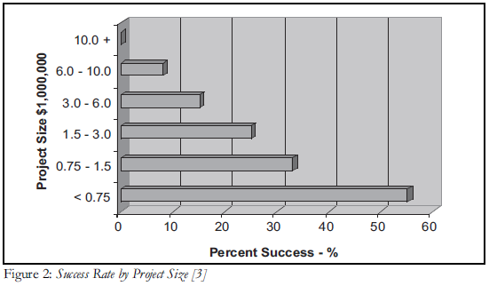
Shocking Statistics
Creator of CMM: Watts S. Humphrey
  ”Software project failures are common and the biggest projects fail most often”
  http://www.la-acm.org/Archives/laacm0512-Why-Big-SW-Projects-Fail0503Humphrey.pdf

Slide 83
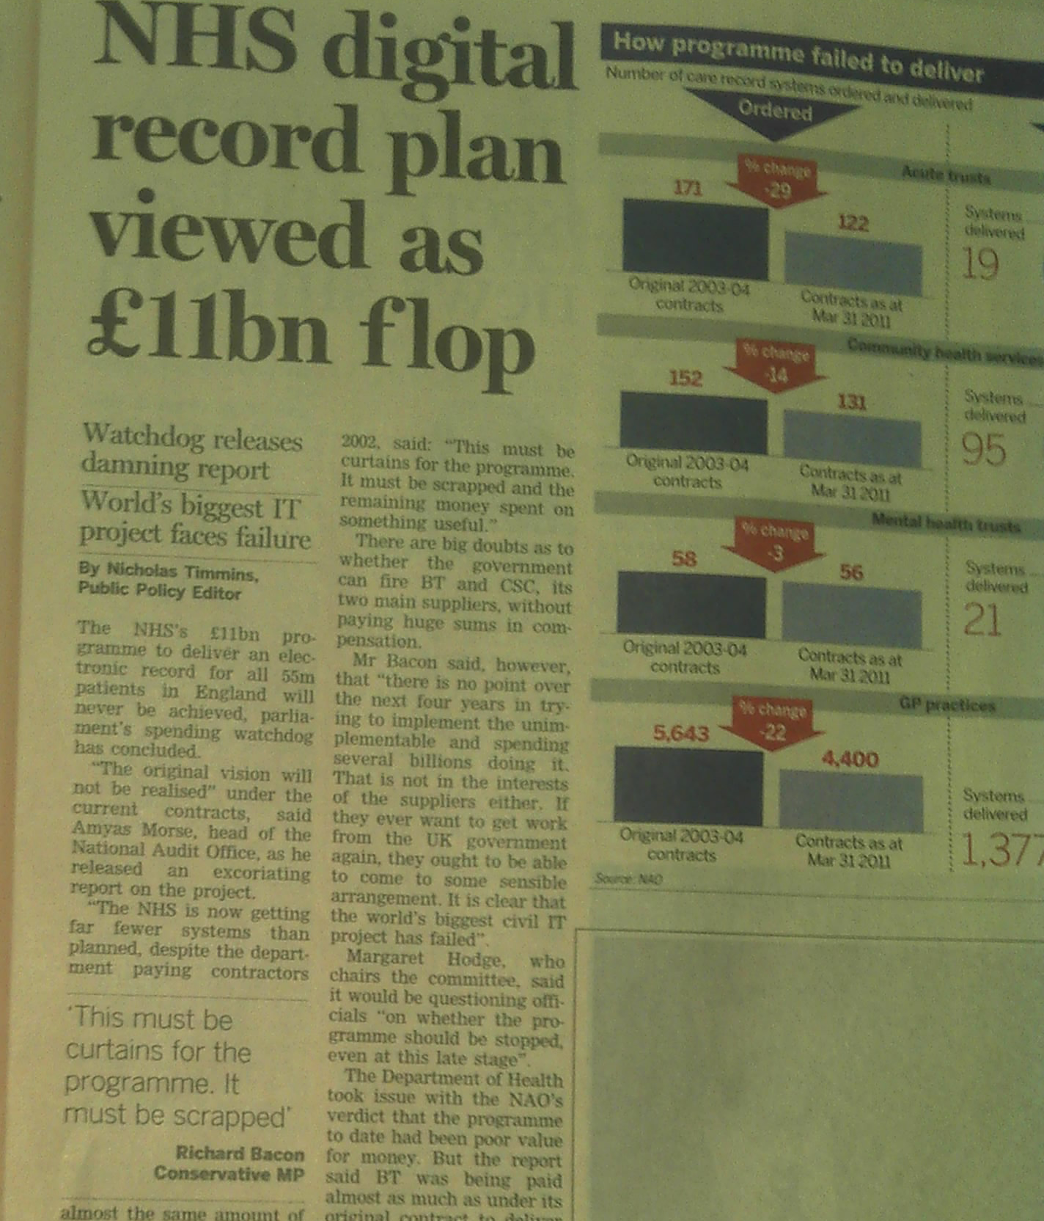
One example of many...
A huge project with lots of money
Potential to do huge benefit...
But why care?
Wait until you need to go to hospital and they dig out paper records...

Slide 84
Software is Important
Software is becoming critical to the running of the world
  And prjects are getting more complex and larger by the year
Large software projects are not well understood
  Very, very difficult
  Often managed by people without software experience or insight
  The challenge is immense (and exciting!)

Slide 85
We Can Make a Big Difference
Engineering approach to large systems
  Break systems down into smaller systems
  Each small system returns a benefit in its own right
  Specify interactions between systems carefully
  Minimise scope, attack complexity from start to end
  Be realistic
We can make a huge difference to the world!
  Our reliance on software is just starting...

